Slide 1
CA2 PDAS-Transport
Haaris Bin Sulaiman
P2112815
DAAA 1B01

Slide 2
DATASETS USED
https://data.gov.sg/dataset/causes-of-road-accidents-causes-of-accidents-by-severity-of-injury-sustained
https://data.gov.sg/dataset/public-transport-utilisation-average-public-transport-ridership
https://data.gov.sg/dataset/climate-change-and-energy-green-vehicles

Slide 3
Nature of Dataset

Slide 4
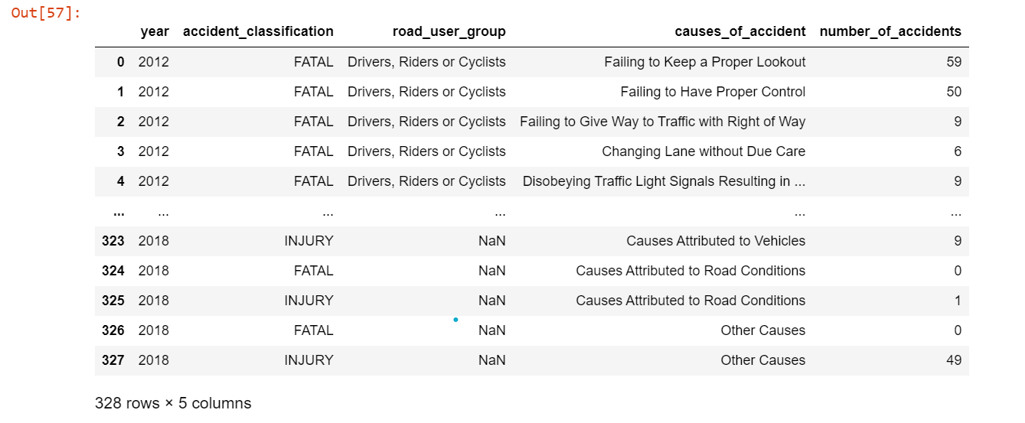
First dataset - causes of accidents

Slide 5
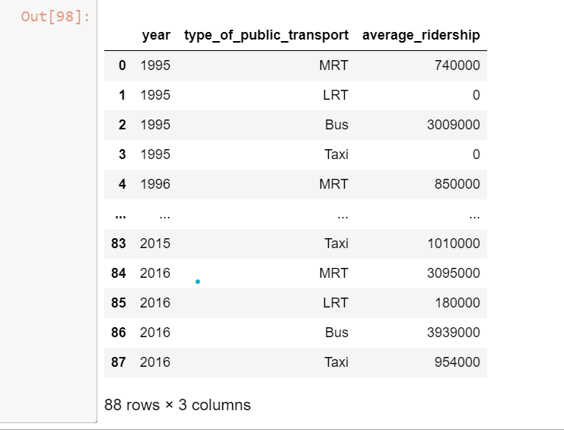
Second Dataset - Public Transport Utilization

Slide 6
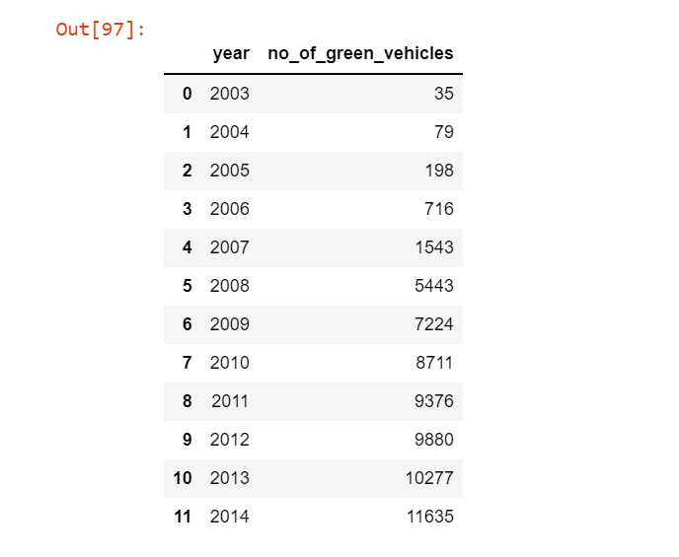
Third dataset - no.green vehicles

Slide 7
Null values and Outliers

Slide 8
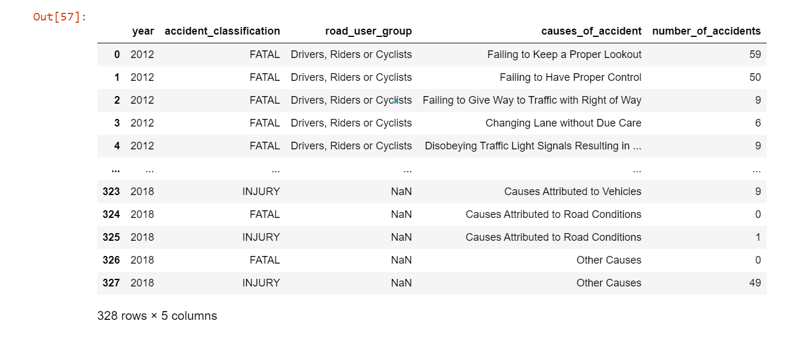
First dataset - causes of accidents

Slide 9
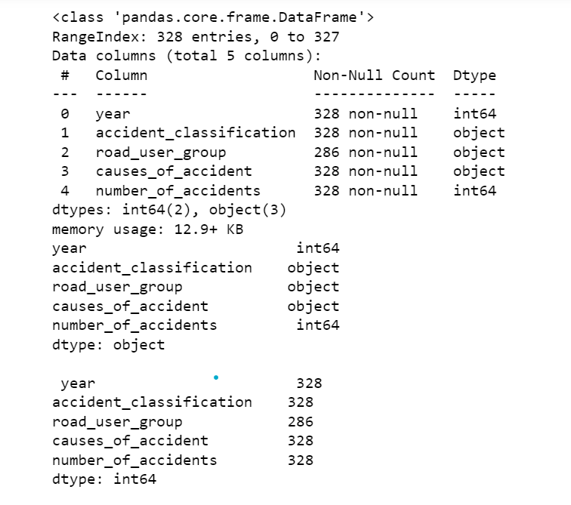
First dataset - printing out info and checking for null

Slide 10
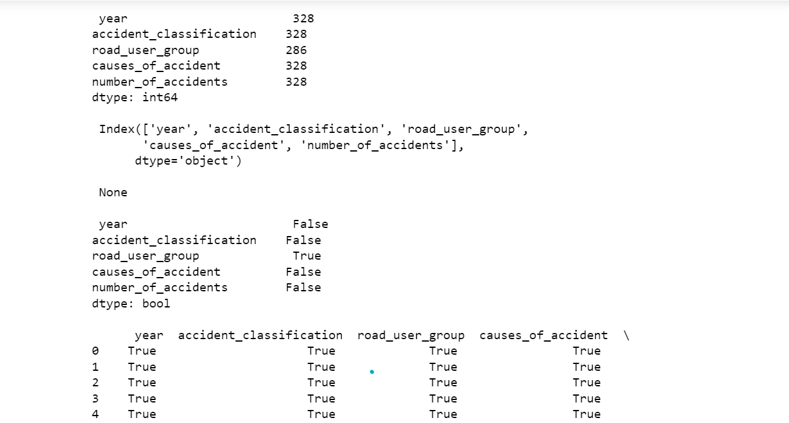
First dataset - columns with null values

Slide 11
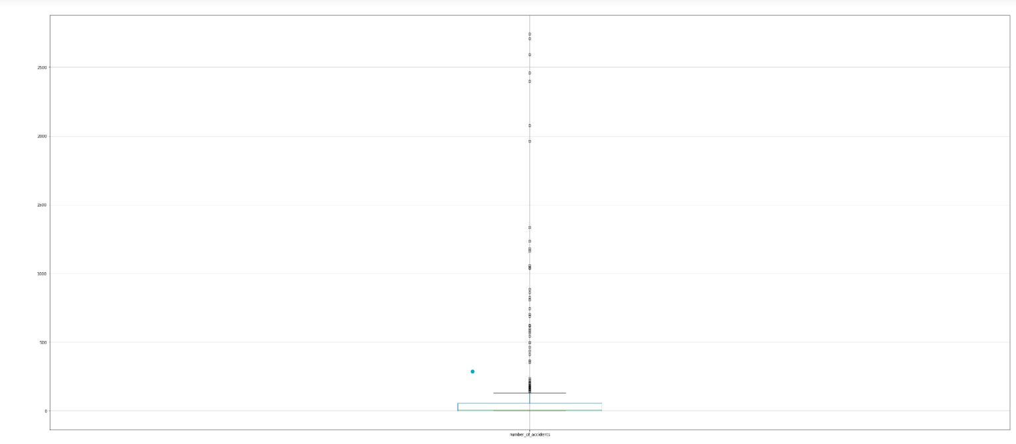
Using Boxplot to detect outliers

Slide 12
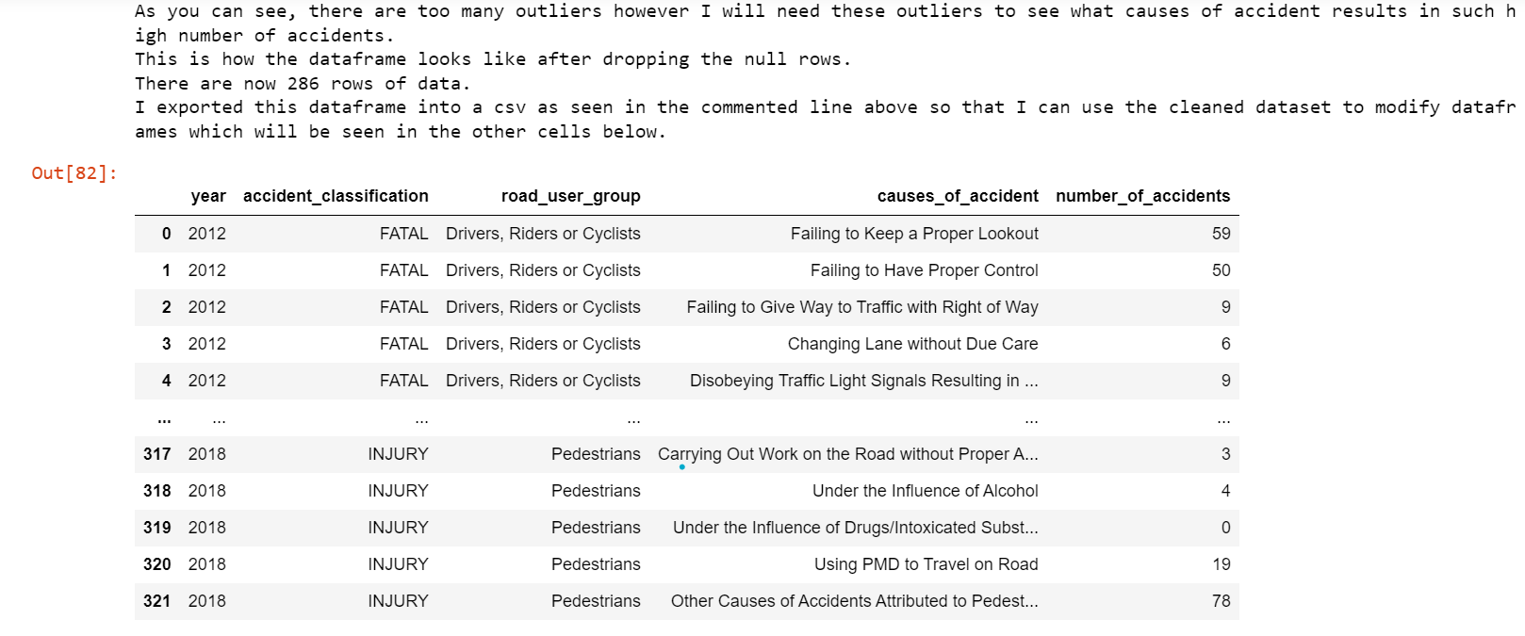
First Dataset - Cleaned Dataframe

Slide 13
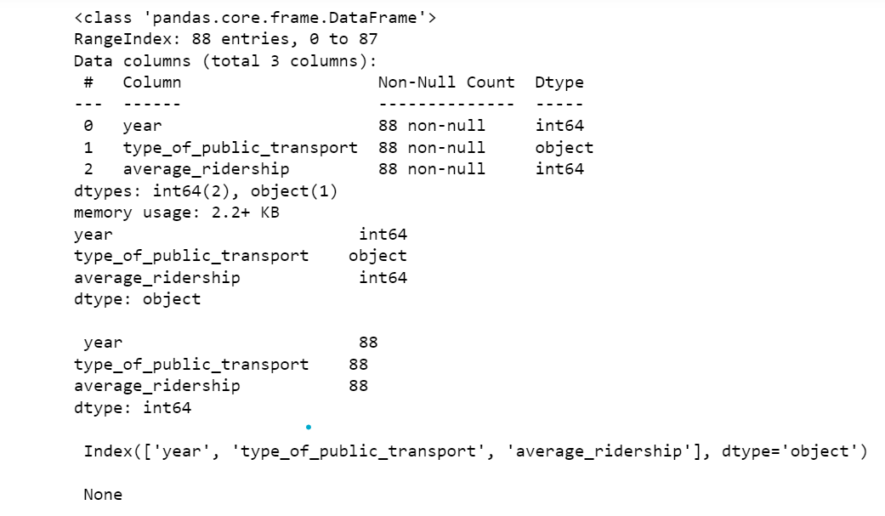
Second Dataset - printing out info and checking for null values

Slide 14
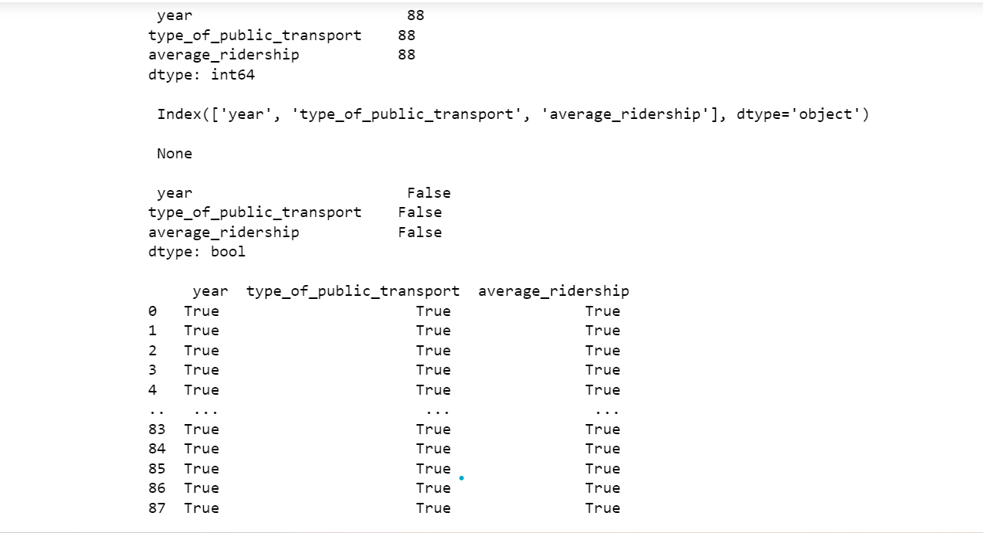
Second Dataset - columns with null values

Slide 15
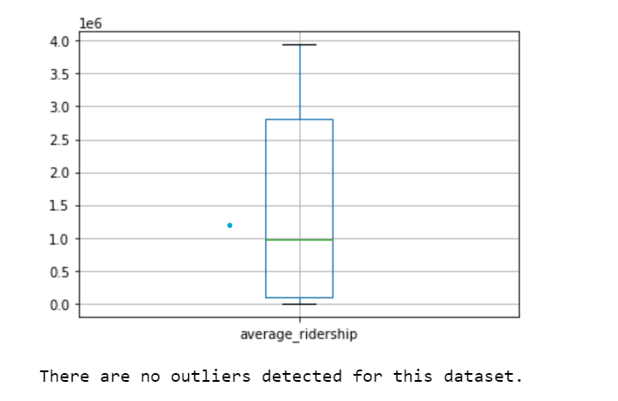
Using Boxplot to detect outliers

Slide 16
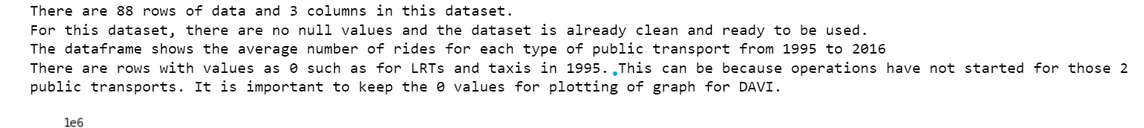
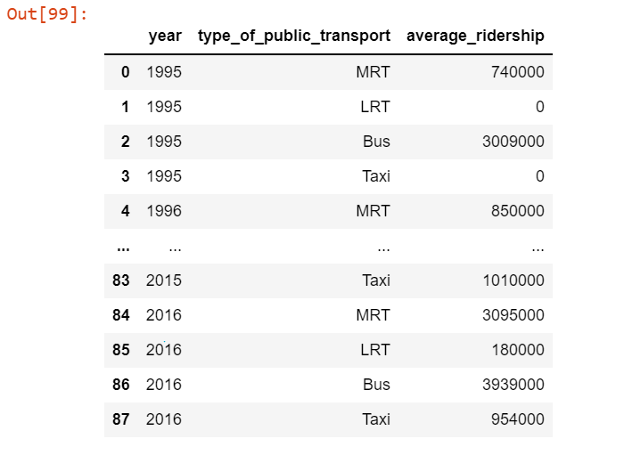
Second dataset - Cleaned Dataframe

Slide 17
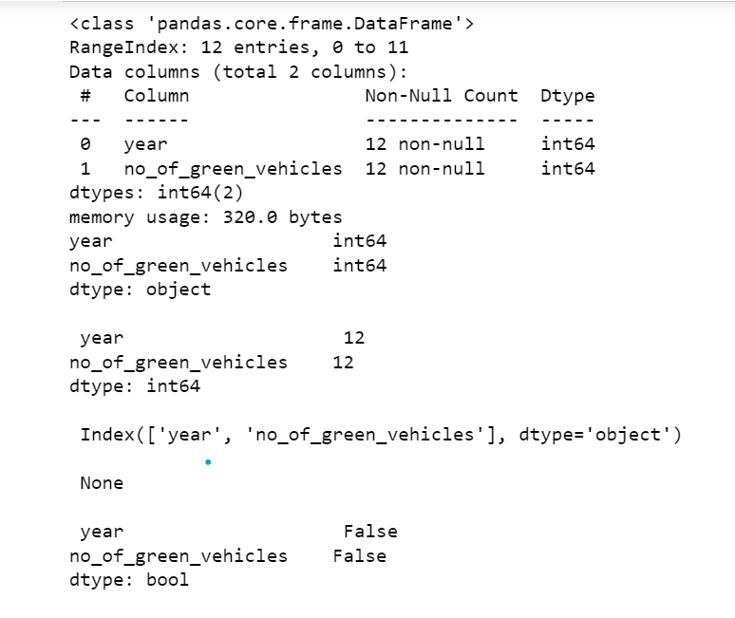
Third dataset - printing out info and checking for null

Slide 18
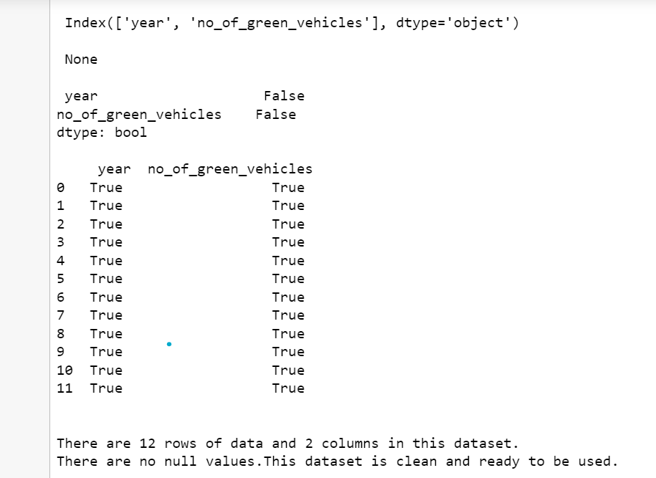
Third Dataset - columns with null values

Slide 19
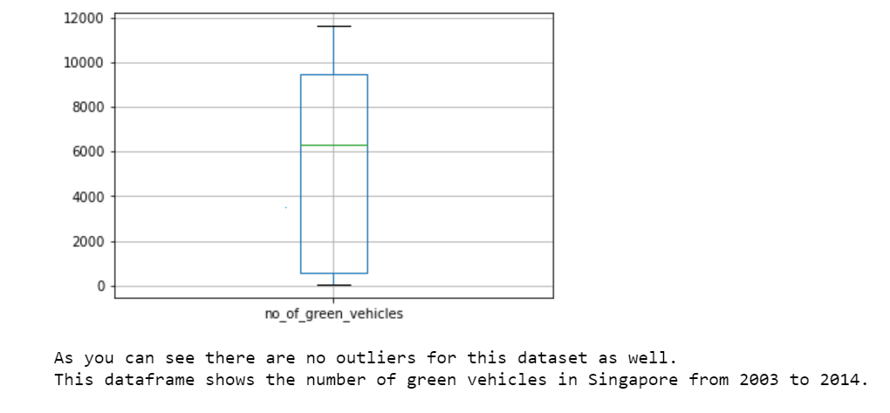
Using Boxplot to detect outliers

Slide 20
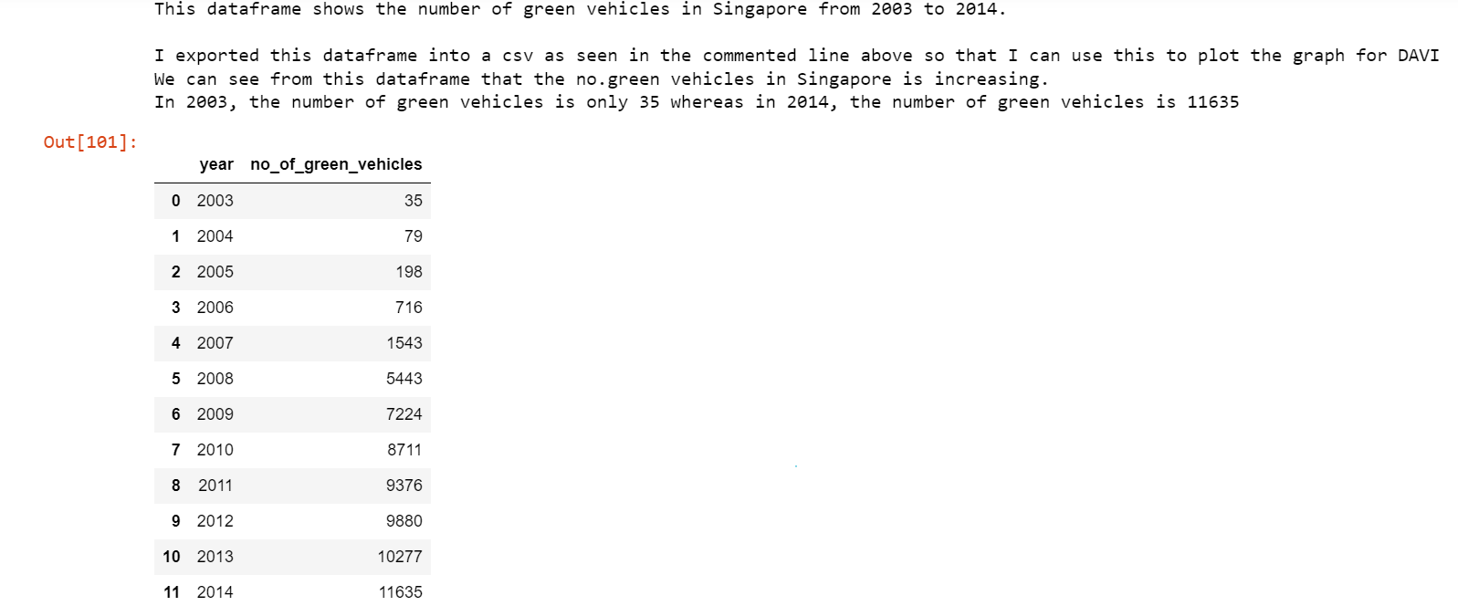
Third dataset - Cleaned Dataframe

Slide 21
Process I went through

Slide 22
First dataset - causes of accidents

Slide 23
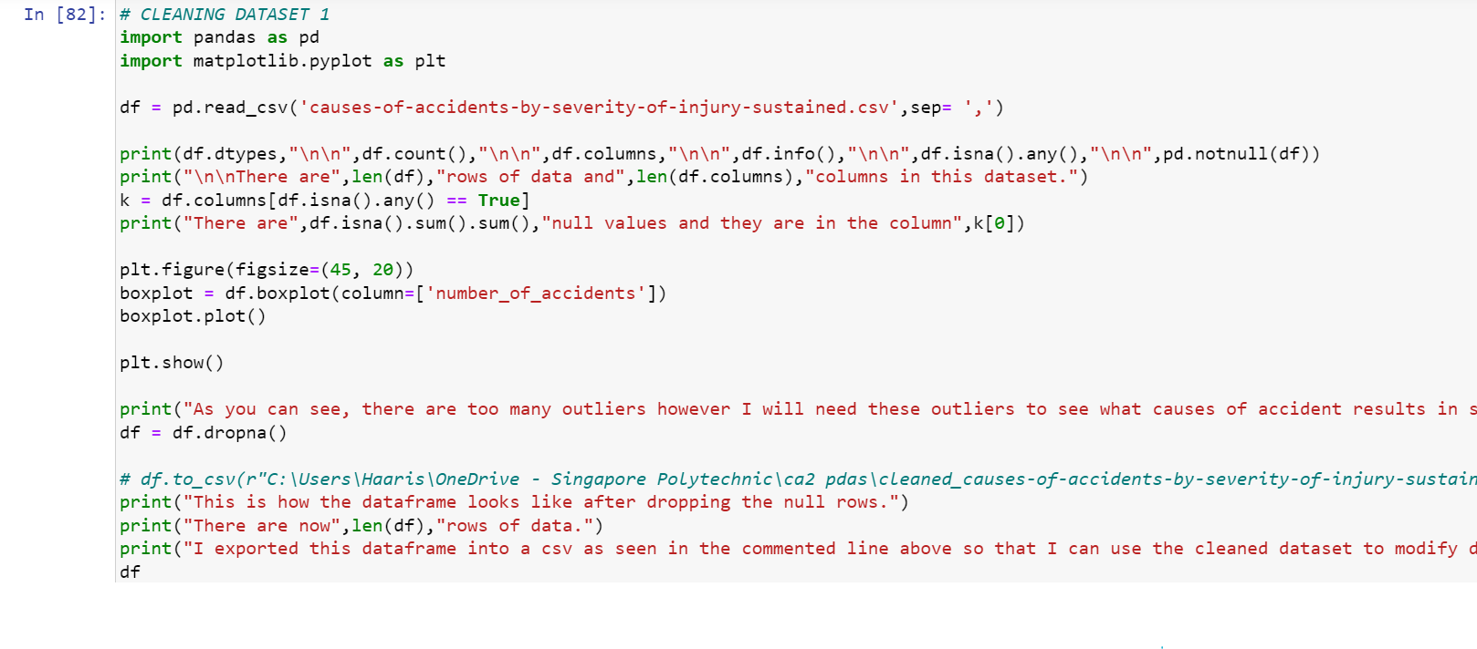

Slide 24
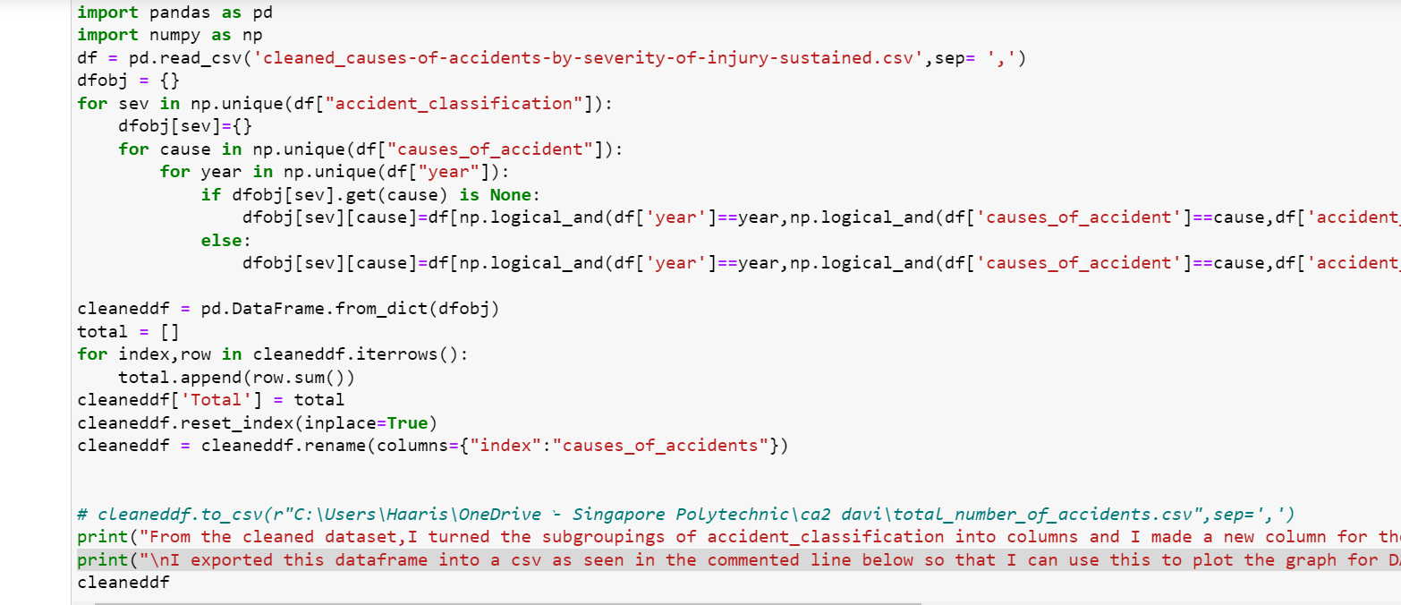

Slide 25
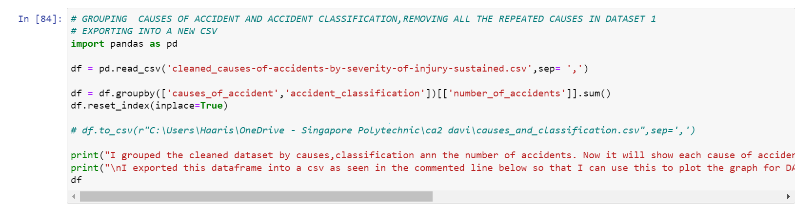

Slide 26
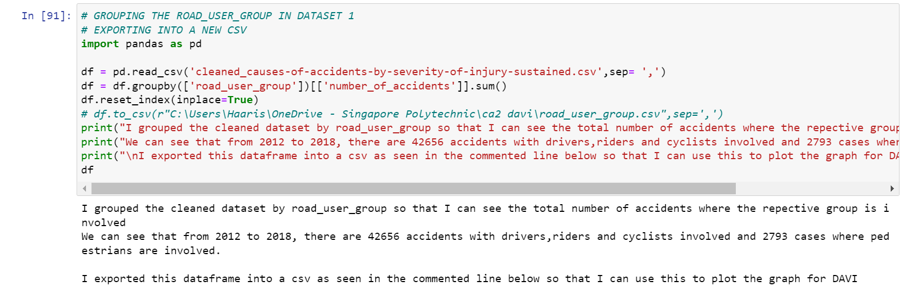

Slide 27
Second Dataset - Public Transport Utilization

Slide 28
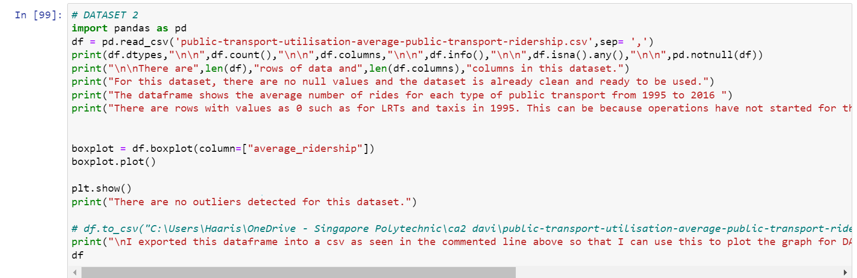

Slide 29
Third dataset - no.green vehicles

Slide 30
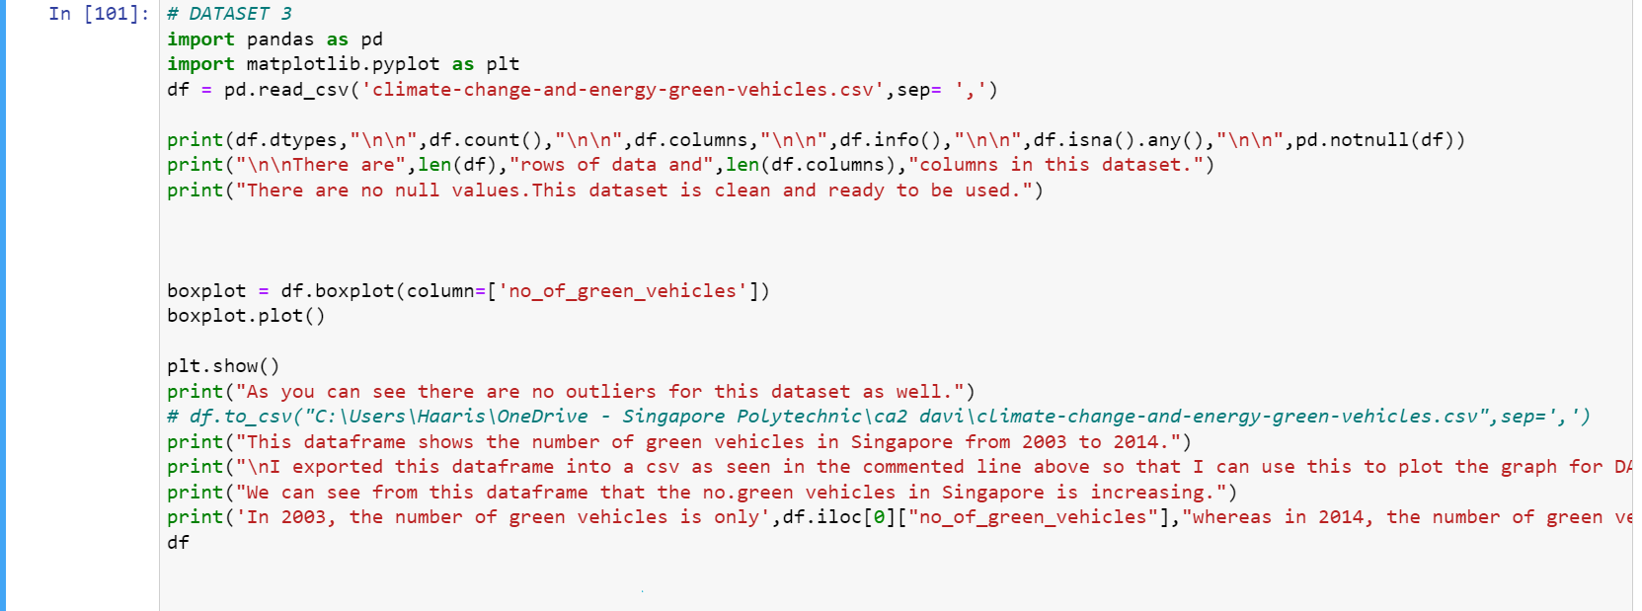

Slide 31
Insights

Slide 32
First dataset - causes of accidents
It is mainly drivers and cyclists who are the main victims and also the cause of accidents
Most accidents in Singapore happen due to drivers failing to keep a proper lookout.
Accidents in Singapore mainly result in injury and the number of accidents that result in fatality is way lower.
The government should enforce checking driving and motorbike license more thoroughly to ensure those who are driving are capable and doing it legally to prevent harm to oneself and others

Slide 33
Second Dataset - Public Transport Utilization
Buses and MRTs are the 2 highly-used public transport
LRTs and Taxis are not utilized as much as buses and MRTs and this can be because LRTs serve a smaller population and taxi fares can be costly.
Over the years, more people have decided to use MRTs and buses and this shows that people are reducing their carbon footprint.
They should construct LRTs at more areas so that a larger population can be facilitated and it makes travelling more convenient.
People will more likely take public transport if it is convenient and affordable.

Slide 34
Third dataset - no.green vehicles
There is a rising trend in the number of green vehicles in Singapore
This shows that there are large contributions made to combating climate change with the rapid increase in green vehicles in Singapore.
There are 11600 more green vehicles in Singapore within 11 years from 2003 to 2014.
Singapore should use advertising and media agencies to raise awareness of the presence of these green vehicles that the public can tap onto so that the carbon footprint will be much less and help combat global warming.

